Slide 1
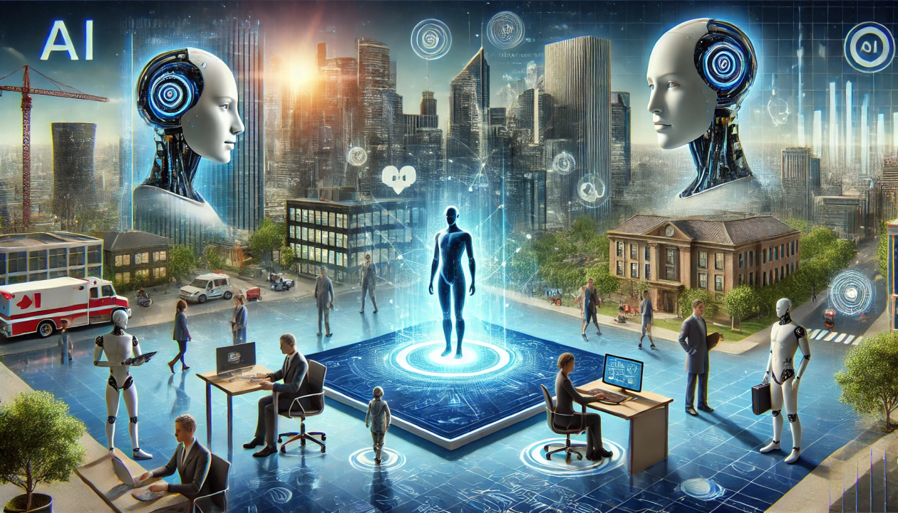
How AI
Enhances
Customer Care

Slide 2
How AI Enhances Customer Care

Slide 3
A Comprehensive Overview
Faster Response Times: AI can handle common queries instantly, reducing wait times and improving customer satisfaction. This is especially useful for handling high volumes of inquiries
Personalized Interactions: AI can analyze customer data to provide personalized recommendations and solutions, enhancing the overall customer experience
Predictive Analytics: AI can predict customer needs and issues before they arise, allowing support teams to proactively address potential problems
Efficient Workflows: AI can automate routine tasks, freeing up human agents to focus on more complex issues. This leads to more efficient and error-free support
Sentiment Analysis: AI can gauge customer emotions during interactions, helping agents respond more empathetically and effectively
Knowledge Management: AI-enhanced knowledge bases can quickly find and provide accurate information, aiding both customers and support agents
24/7 Availability: AI-powered chatbots and virtual assistants can provide round-the-clock support, ensuring customers get help anytime they need it
Faster Response Times
Personalized Interactions
Predictive Analytics
Efficient Workflows
Sentiment Analysis
AI in Customer care
Knowledge Management
24/7 Availability

